Slide 1
DeMolay
“ An organization for young men ages”
12-21

Slide 2
Our object is to help boys become strong men and have an experience of an life time.

Slide 3
The World’s largest
Fraternity for
Young Men

Slide 4
It has been said that a day can be changed or a great moment launched by a single phone call.

Slide 5
DeMolay is an organization dedicated to preparing young men to lead successful, happy, and productive lives. Basing its approach on timeless principles and practical, hands-on experience,
DeMolay opens doors for young men aged 12 to 21 by developing the civic awareness, personal responsibility and leadership skills so vitally needed in society today.
DeMolay combines this serious mission with a fun approach that builds important bonds of friendship among members in more than 1,000 chapters worldwide.

Slide 6
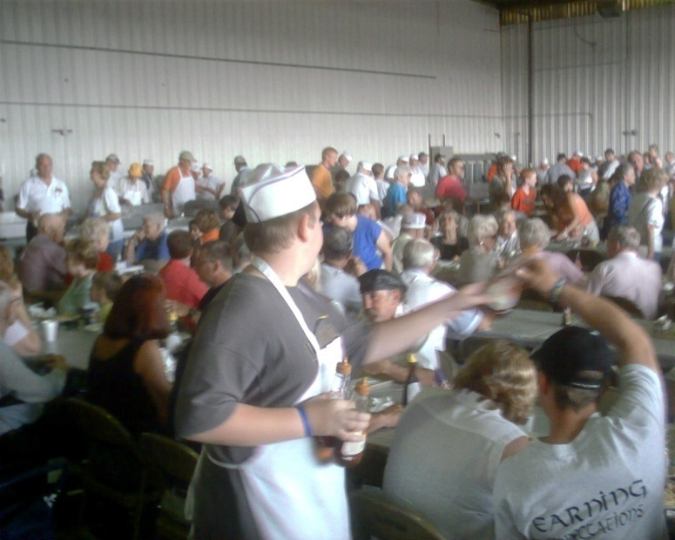
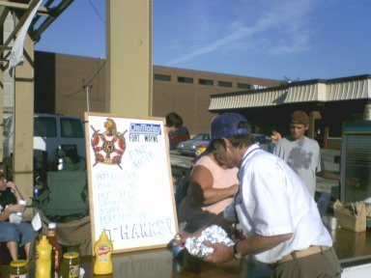
Raising Money

Slide 7
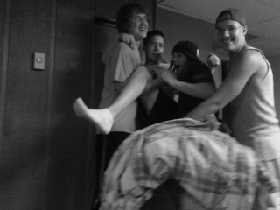
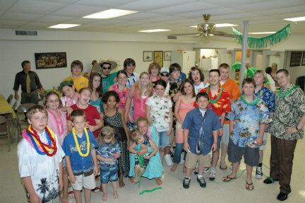
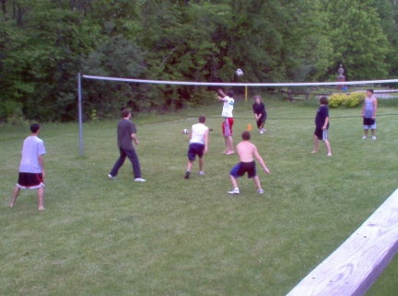
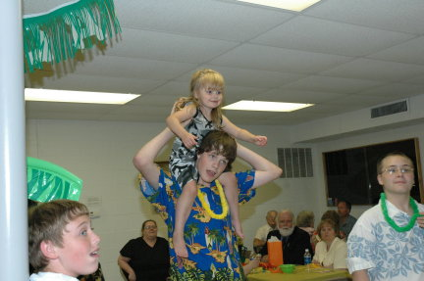
FUN

Slide 8
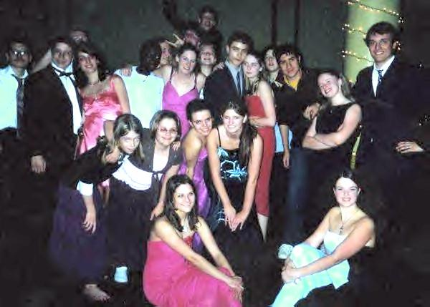
Lets Dance

Slide 9
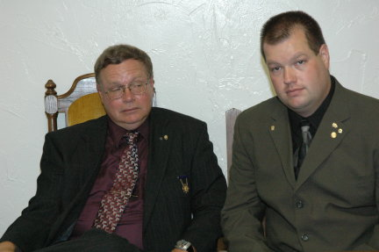
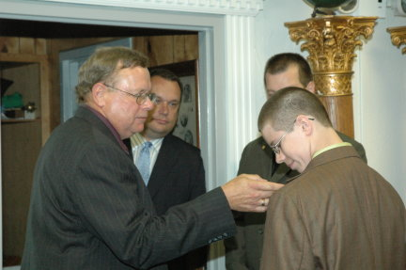
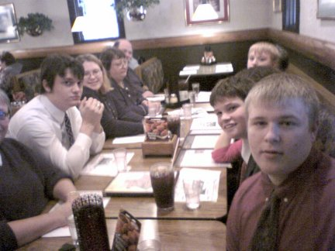
Brother hood

Slide 10
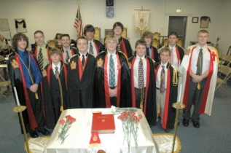
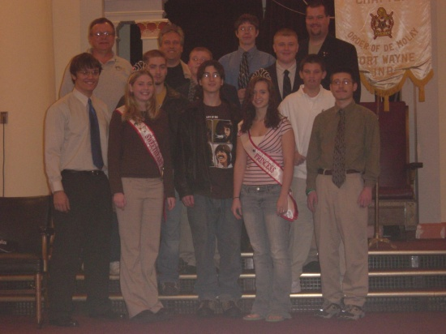
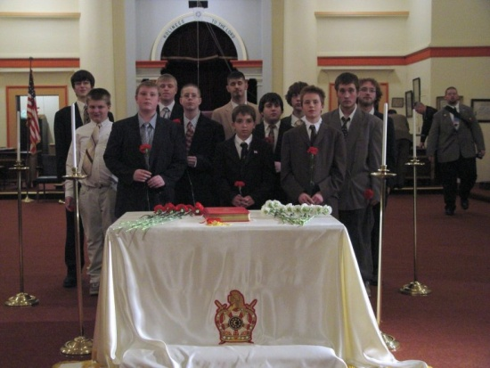
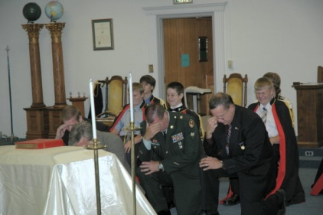
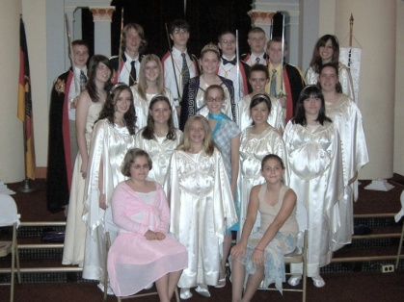
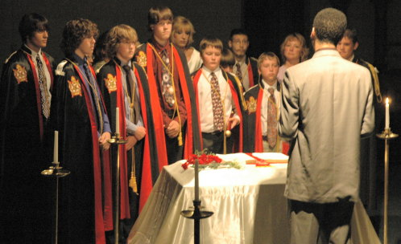

Slide 11
The Order Of DeMolay

Slide 12
The namesake of our Order
Jacques DeMolay

Slide 13
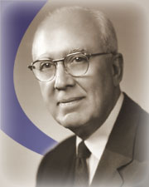
The Order of DeMolay was founded in 1919, in Kansas City, Missouri, by a young man named Frank S. Land. Land was a community leader who, at the age of 28, already had a successful business career as a restaurateur behind him.

Slide 14
The 1st man to say
Louis G. Lower
“I am a DeMolay”

Slide 15
Author of our Ritual | Frank A. Marshall

Slide 16
The Seven Cardinal Virtues
"Filial Love" Love between parent and child
"Reverence for Sacred Things" Encourages one's own faith and tolerance for others' beliefs
"Courtesy" Courtesy to all mankind to make life more pleasant
"Comradeship" Loyalty and faithfulness to friends and family
"Fidelity" Encourages loyalty to promises, vows, friends and God
"Cleanliness" Cleanness of mind, body and spirit
"Patriotism" Encourages loyalty to country, freedom and civic responsibility

Slide 17
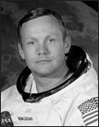
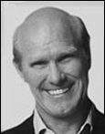
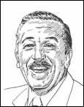
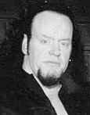
Famous DeMolays
Neil Armstrong - Test Pilot, Astronaut and First Human Being to Walk on the Moon
Terry Bradshaw - NFL Quarterback who led the Pittsburgh Steelers to Four Super Bowl Championships and a Pro Football Hall of Fame Inductee
Walt Disney - Cartoonist, Producer, Creator and Businessman
Mark Callaway - Professional Wrestler for World Wrestling Entertainment, who goes by the Wrestling Name "The Undertaker"
Just To Name a Few

Slide 18
Are You Ready for an experience
of a Life time………..

Slide 19
JOIN NOW!!!!!!
JOIN NOW!!!!!!

Slide 20
Created By: Members of Fort Wayne Chapter
Go To
Fortwaynedemolay.com
Or
Demolay.org
Or call : 1-800-DeMolay
For More INFO

